Slide 1
ESG and Firm’s Default Risk Finance Research Letters 47, 102713 (2022). H. Li et al.
https://www.sciencedirect.com/science/article/pii/S154461232200040X

Slide 2
要旨
Year-by-season, firm fixed effectsを使って、ESGスコアは中国の上場企業のデフォルトリスクを軽減していることが判明
デフォルトリスクの期間構造が1か月、6か月から12か月にかけて増えるように、ESGによる軽減効果も増えた。
製造業のほうが非製造業よりもESGスコアによるデフォルトリスク軽減の効果は小さかった。ESGに規定が製造業のほうがより厳密であるため。

Slide 3
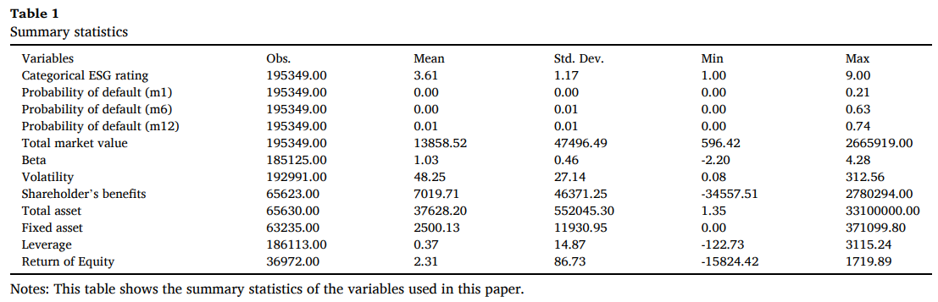
データ
Firm’s default probability data
Risk Management Institute (RMI) of the National University of Singapore (NUS)
ESG Rating data from 2015 to 2020
Sino-Securities Index Information Service of the Wind database
The ESG rating from AAA to C → 1 to 9
コントロール変数
Monthly total market value, beta, volatility of stock price, firm’s leverage

Slide 4
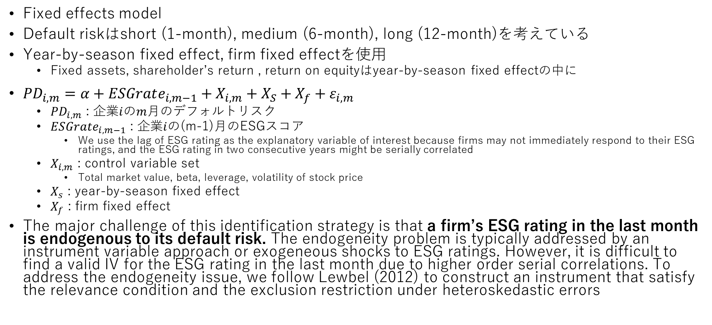
methodology
Fixed effects model
Default riskはshort (1-month), medium (6-month), long (12-month)を考えている
Year-by-season fixed effect, firm fixed effectを使用
Fixed assets, shareholder’s return , return on equityはyear-by-season fixed effectの中に
$PD_{i,m}=α+ESGrate_{i,m−1}+X_{i,m}+X_{S}+X_{f}+ε_{i,m}$
$PD_{i,m}$ : 企業$i$の$m$月のデフォルトリスク
$ESGrate_{i,m−1}$ : 企業$i$の(m-1)月のESGスコア
We use the lag of ESG rating as the explanatory variable of interest because firms may not immediately respond to their ESG ratings, and the ESG rating in two consecutive years might be serially correlated
$X_{i,m}$ : control variable set
Total market value, beta, leverage, volatility of stock price
$X_{s}$ : year-by-season fixed effect
$X_{f}$ : firm fixed effect
The major challenge of this identification strategy is that a firm’s ESG rating in the last month is endogenous to its default risk. The endogeneity problem is typically addressed by an instrument variable approach or exogeneous shocks to ESG ratings. However, it is difficult to find a valid IV for the ESG rating in the last month due to higher order serial correlations. To address the endogeneity issue, we follow Lewbel (2012) to construct an instrument that satisfy the relevance condition and the exclusion restriction under heteroskedastic errors

Slide 5
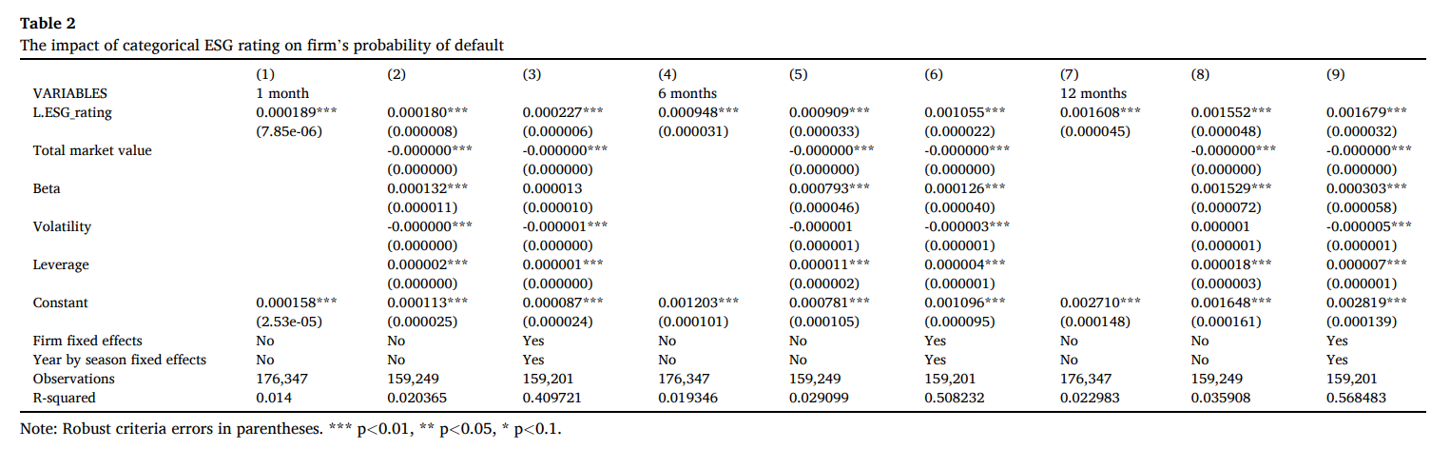
Empirical result : Main results
ESG ratingはPDに効果あり
1,6,12-monthになるにしたがってESG軽減効果は大きくなっている
0.022% -> 0.106% -> 0.168%
解釈
ESGへの投資は将来的に企業のパフォーマンスを向上させデフォルトリスクを軽減させる(Nguyen et a. 2020)
社会的に責任のある企業(socially responsible)ほど政治的なコネクションがあり、クレジットスコアがよい (Jiraporn et al. 2014, Lin et al, 2015)

Slide 6
補足(詳細は勉強中…)
As mentioned, The Lewbel IV approach is widely used when sufficient instruments are not available. Therefore, we instrument the lag of ESG rating with a constructed IV following Lewbel (2012). The results are presented in Table A1 of the appendix. Using a 2SLS regression analysis, we find that the coefficients of the lag of ESG rating in Table A1 is almost identical to the coefficients in Table 2. Our instruments pass the Sargan test of over-identification.
To test whether our model is robust in different orders of autocorrelation, we further estimate Eq. (1) with two lags, or level and lag of the ESG rating variable. The results are presented in Tables A2-A3 of the appendix. We consistently find that higher ESG ratings are associated with smaller default risk and the risk mitigation effect of ESG rating on firms’ PD increases as the studied period become longer. We also conduct a robustness check using a dummy ESG rating as the dependent variable. We define a “dummy ESG rating measure” where the dummy variable equals 1 indicates a firm is rated above A, zero otherwise. The results are presented in Table A4 in the appendix. Our findings suggest that a Chinese listed firm with an A ESG-rating and above has significantly lower short-, mediumand long-term default risks than their counterparts.

Slide 7
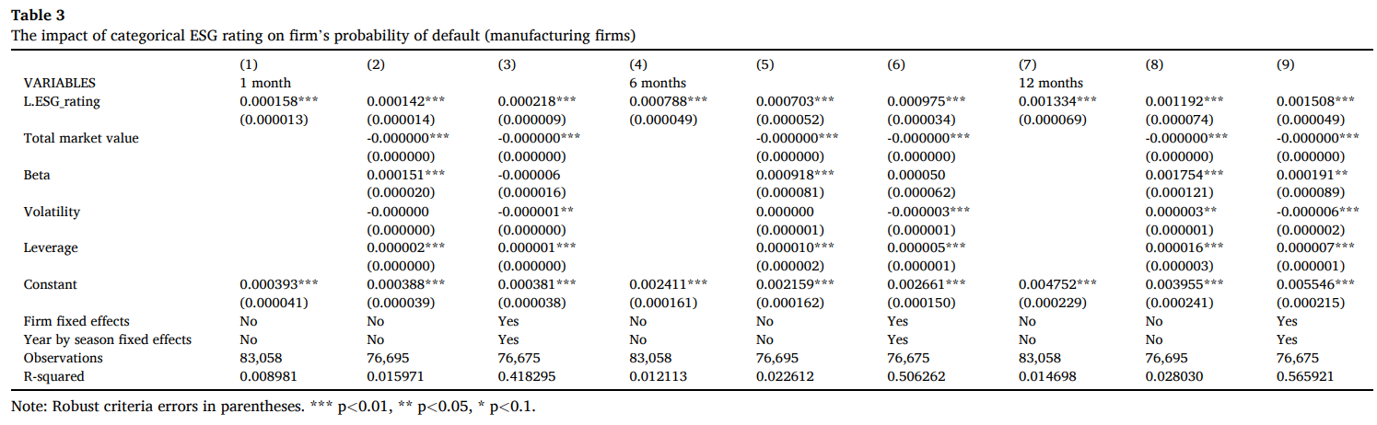
Heterogeneity by industry

Slide 8
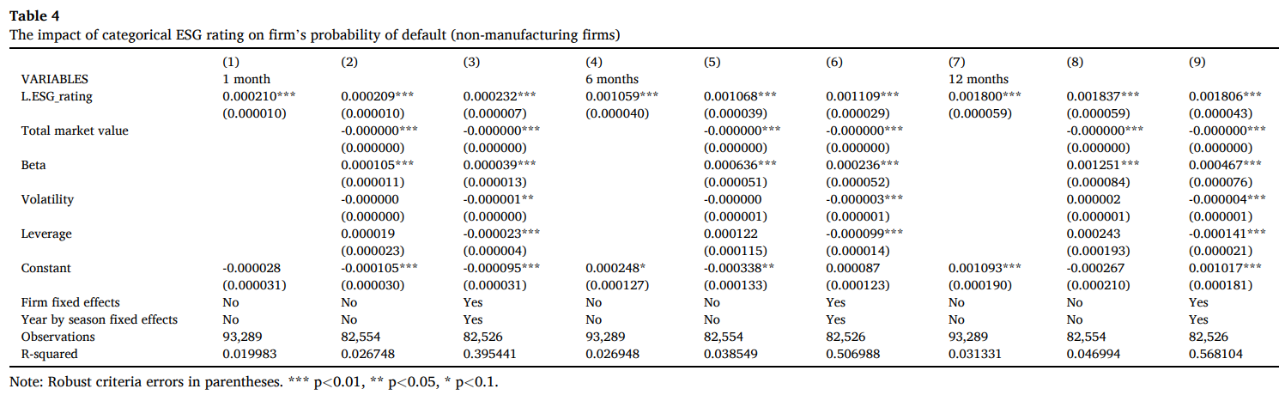
Heterogeneity by industry

Slide 9
わかったこと
両セクター(製造業/非製造業)ともにESG ratingに影響を受けている
長期間のほうがインパクトが大きい
製造業のほうが非製造業よりもインパクトが小さい

